Slide 1
Lecture 1
Abrar Hasan
Lecturer
Department of Software Engineering
Daffodil International University

Slide 2
Class & Objects

Slide 3
What is Object
An object in Java is the physical as well as a logical entity, whereas, a class in Java is a logical entity only.
An entity that has state and behavior is known as an object e.g., chair, bike, marker, pen, table, car, etc.
It can be physical or logical (tangible and intangible). The example of an intangible object is the banking system.

Slide 4
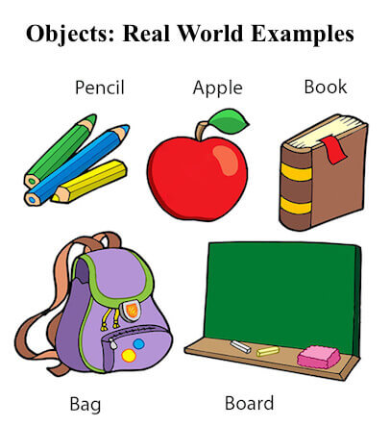
What is Object (Cont.)

Slide 5
What is Object (Cont.)
An object has three characteristics:
State: represents the data (value) of an object.
Behavior: represents the behavior (functionality) of an object such as deposit, withdraw, etc.
Identity: An object identity is typically implemented via a unique ID. The value of the ID is not visible to the external user. However, it is used internally by the JVM (Java Virtual Machine) to identify each object uniquely.
For Example, Pen is an object. Its name is Reynolds; color is white, known as its state. It is used to write, so writing is its behavior.

Slide 6
What is Object (Cont.)
An object is an instance of a class. A class is a template or blueprint from which objects are created. So, an object is the instance(result) of a class.
Object Definitions:
An object is a real-world entity.
An object is a runtime entity.
The object is an entity which has state and behavior.
The object is an instance of a class.

Slide 7
What is Class
A class is a group of objects which have common properties.
It is a template or blueprint from which objects are created. It is a logical entity. It can't be physical.
A class in Java can contain:
Fields
Methods
Constructors
Blocks
Nested class and interface

Slide 8
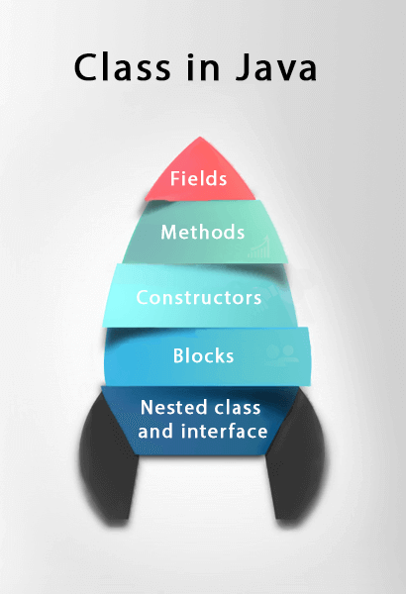
What is Class (Cont.)

Slide 9
What is Class (Cont.)
Syntax to declare a class:
class <class_name>{
field;
method;
}

Slide 10
Instance Variable in Java
A variable which is created inside the class but outside the method is known as an instance variable.
Instance variable doesn't get memory at compile time.
It gets memory at runtime when an object or instance is created.
That is why it is known as an instance variable.

Slide 11
Method in Java
In Java, a method is like a function which is used to expose the behavior of an object.
Advantage of Method
Code Reusability
Code Optimization

Slide 12
New Keyword in Java
The new keyword is used to allocate memory at runtime.
All objects get memory in Heap memory area.

Slide 13
Constructor in Java
In Java, a constructor is a block of codes similar to the method.
It is called when an instance of the class is created.
At the time of calling constructor, memory for the object is allocated in the memory.

Slide 14
Object and Class Example: main within the class
In this example, we have created a Student class which has two data members id and name. We are creating the object of the Student class by new keyword and printing the object's value.
Here, we are creating a main() method inside the class.
File: Student.java

Slide 15
Object and Class Example: main within the class
//Java Program to illustrate how to define a class and fields
//Defining a Student class.
class Student{
//defining fields
int id;//field or data member or instance variable
String name;
//creating main method inside the Student class
public static void main(String args[]){
//Creating an object or instance
Student s1=new Student();//creating an object of Student
//Printing values of the object
System.out.println(s1.id);//accessing member through reference variable
System.out.println(s1.name); }
}
Output:
0
Null
Output:
0
null

Slide 16
Object and Class Example: main outside the class
In real time development, we create classes and use it from another class. It is a better approach than previous one. Let's see a simple example, where we are having main() method in another class.
We can have multiple classes in different Java files or single Java file. If you define multiple classes in a single Java source file, it is a good idea to save the file name with the class name which has main() method.
File: TestStudent1.java

Slide 17
Object and Class Example: main outside the class
//Java Program to demonstrate having the main method in
//another class
//Creating Student class.
class Student{
int id;
String name;
}
//Creating another class TestStudent1 which contains the main method
class TestStudent1{
public static void main(String args[]){
Student s1=new Student();
System.out.println(s1.id);
System.out.println(s1.name); }
}
Output:
0
null

Slide 18
3 Ways to Initialize Object
There are 3 ways to initialize object in Java.
By reference variable
By method
By constructor

Slide 19
1) Object and Class Example: Initialization through reference
Initializing an object means storing data into the object. Let's see a simple example where we are going to initialize the object through a reference variable.
File: TestStudent2.java
class Student{
int id;
String name;
}
class TestStudent2{
public static void main(String args[]){
Student s1=new Student();
s1.id=101;
s1.name="Sonoo";
System.out.println(s1.id+" "+s1.name);//printing members with a white space
}
}
Output:
101 Sonoo

Slide 20
1) Object and Class Example: Initialization through reference (Cont.)
We can also create multiple objects and store information in it through reference variable.
File: TestStudent3.java
class Student{ int id; String name; } class TestStudent3{ public static void main(String args[]){ //Creating objects Student s1=new Student(); Student s2=new Student(); | //Initializing objects s1.id=101; s1.name="Sonoo"; s2.id=102; s2.name="Amit"; //Printing data System.out.println(s1.id+" "+s1.name); System.out.println(s2.id+" "+s2.name); } }
Output:
101 Sonoo
102 Amit

Slide 21
2) Object and Class Example: Initialization through method
In this example, we are creating the two objects of Student class and initializing the value to these objects by invoking the insertRecord method. Here, we are displaying the state (data) of the objects by invoking the displayInformation() method.
File: TestStudent4.java
class Student{ int rollno; String name; void insertRecord(int r, String n){ rollno=r; name=n; } void displayInformation(){System.out.println(rollno+" "+name);} } | class TestStudent4{ public static void main(String args[]){ Student s1=new Student(); Student s2=new Student(); s1.insertRecord(111,"Karan"); s2.insertRecord(222,"Aryan"); s1.displayInformation(); s2.displayInformation(); } }
Output:
111 Karan
222 Aryan

Slide 22
3) Object and Class Example: Initialization through a constructor
We will learn about constructors in Java later.
Object and Class Example: Employee
Let's see an example where we are maintaining records of employees.
File: TestEmployee.java
class Employee{ int id; String name; float salary; void insert(int i, String n, float s) { id=i; name=n; salary=s; } void display(){System.out.println(id+" "+name+" "+salary);} } | public class TestEmployee { public static void main(String[] args) { Employee e1=new Employee(); Employee e2=new Employee(); Employee e3=new Employee(); e1.insert(101,"ajeet",45000); e2.insert(102,"irfan",25000); e3.insert(103,"nakul",55000); e1.display(); e2.display(); e3.display(); } }
Output:
101 ajeet 45000.0
102 irfan 25000.0
103 nakul 55000.0

Slide 23
References
https://www.javatpoint.com/object-and-class-in-java
https://en.wikipedia.org/wiki/Java_virtual_machine#:~:text=A%20Java%20virtual%20machine%20(JVM,required%20in%20a%20JVM%20implementation.
https://www.javatpoint.com/java-constructor

Slide 24
Thank You

